Slide 1
Secure data hiding in images using Steganography
CAPSTONE PROJECT
Presented By:
Student Name : Gowtham Geddada
College Name & Department : Sagi Rama Krishnam Raju
Engineering College,Bhimavaram,
534204.AI&DS department

Slide 2
OUTLINE
Problem Statement
Technology used
Wow factor
End users
Result
Conclusion
Git-hub Link
Future scope

Slide 3
Problem Statement
Data security is a crucial concern in the digital world, especially when transmitting sensitive information. Traditionally encryption methods can be complex and require external storage for encrypted files. This project introduces an image-based encryption and decryption system that allows users to hide secret messages inside images securely. The decryption process is protected with a password, ensuring only authorized access.
Challenges Addressed:
Difficulty in securely sharing text messages.
Risk of data exposure in plaintext format.
Lack of simple encryption tools for non-technical users.

Slide 4
Technology used
Programming Language:
Python – Used for building encryption and decryption logic.
Libraries & Frameworks:
OpenCV – Handles image processing and manipulation.
Numpy – Supports array-based operations for embedding messages.
PyQt6 – Creates a user-friendly GUI for encryption and decryption.
Platforms:
Runs on Windows, Linux and macOS with python installed.

Slide 5
Wow factors
Why is this project Unique?
Steganography-based encryption – Instead of traditional encryption, the message is embedded within the pixel values of an image.
User-friendly GUI – No need for command-line operations; everything is handled through an interactive interface.
Password protection - The message can only be decrypted with the correct password, adding a layer of security.
No need for additional storage – The message is stored inside the image itself, eliminating the need for external encrypted files.

Slide 6
End users
Cybersecurity Enthusiasts – To explore encryption steganography techniques.
Journalists & Activists - Securely share confidential information without detection.
Students & Researchers - Learn about cryptography and image processing.
Photography & Designers – Protect copyright information within images.
General Users – Hide private messages or data securely within images.

Slide 7
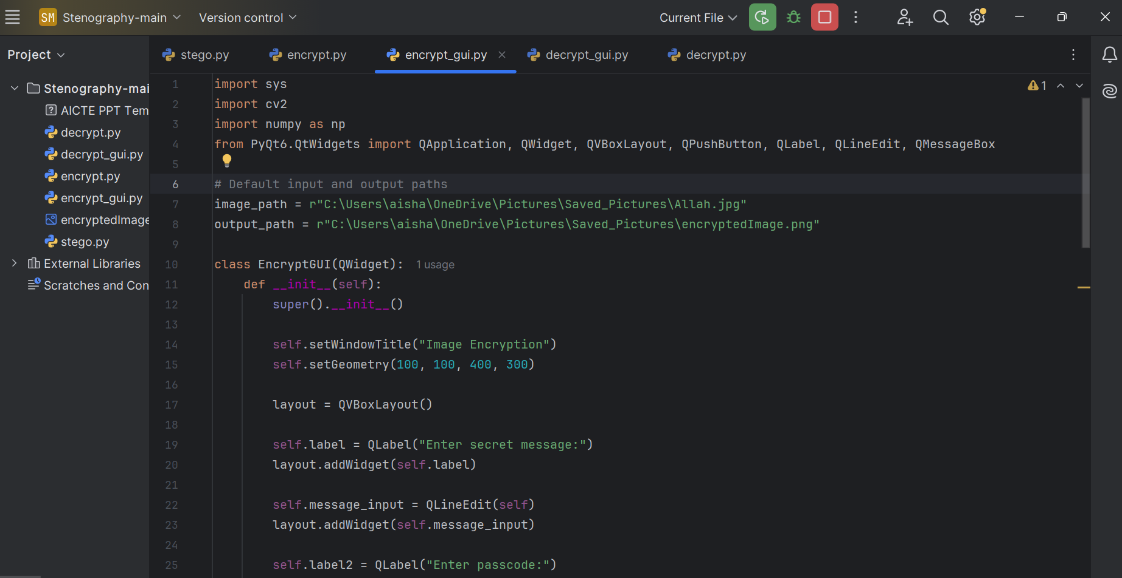
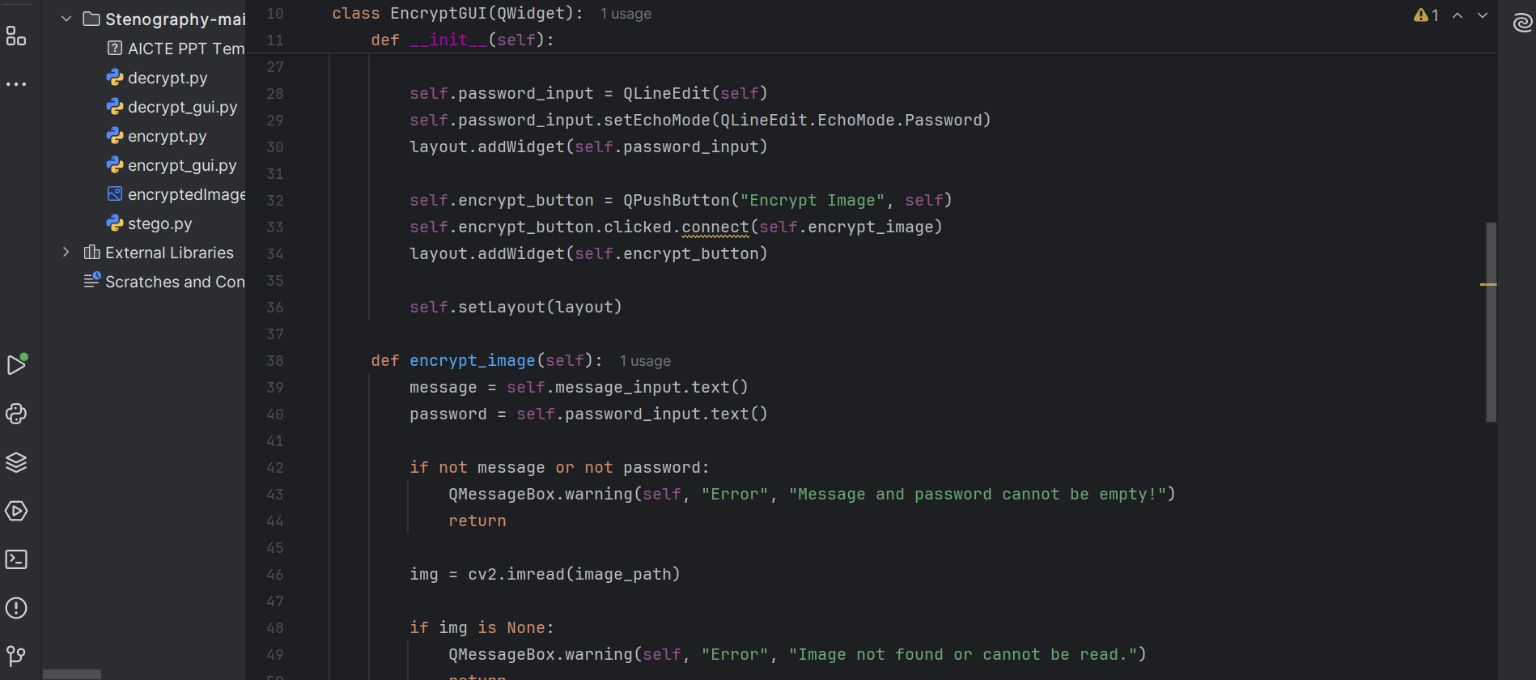
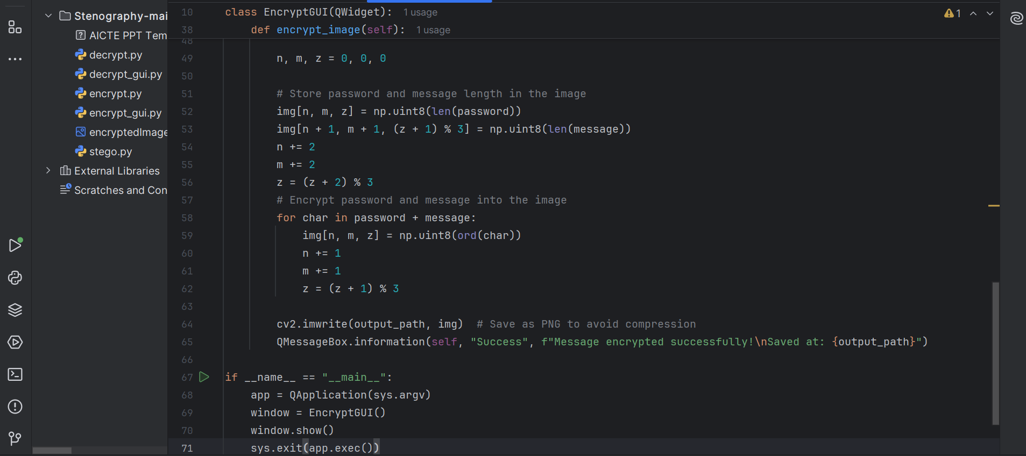
Results
Figure 1: Encryption Code

Slide 8
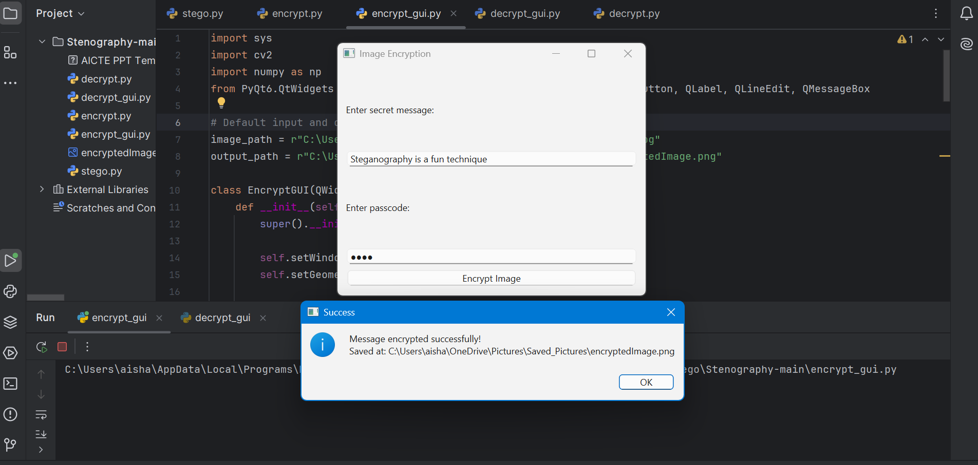
Figure 2: Encryption Output

Slide 9
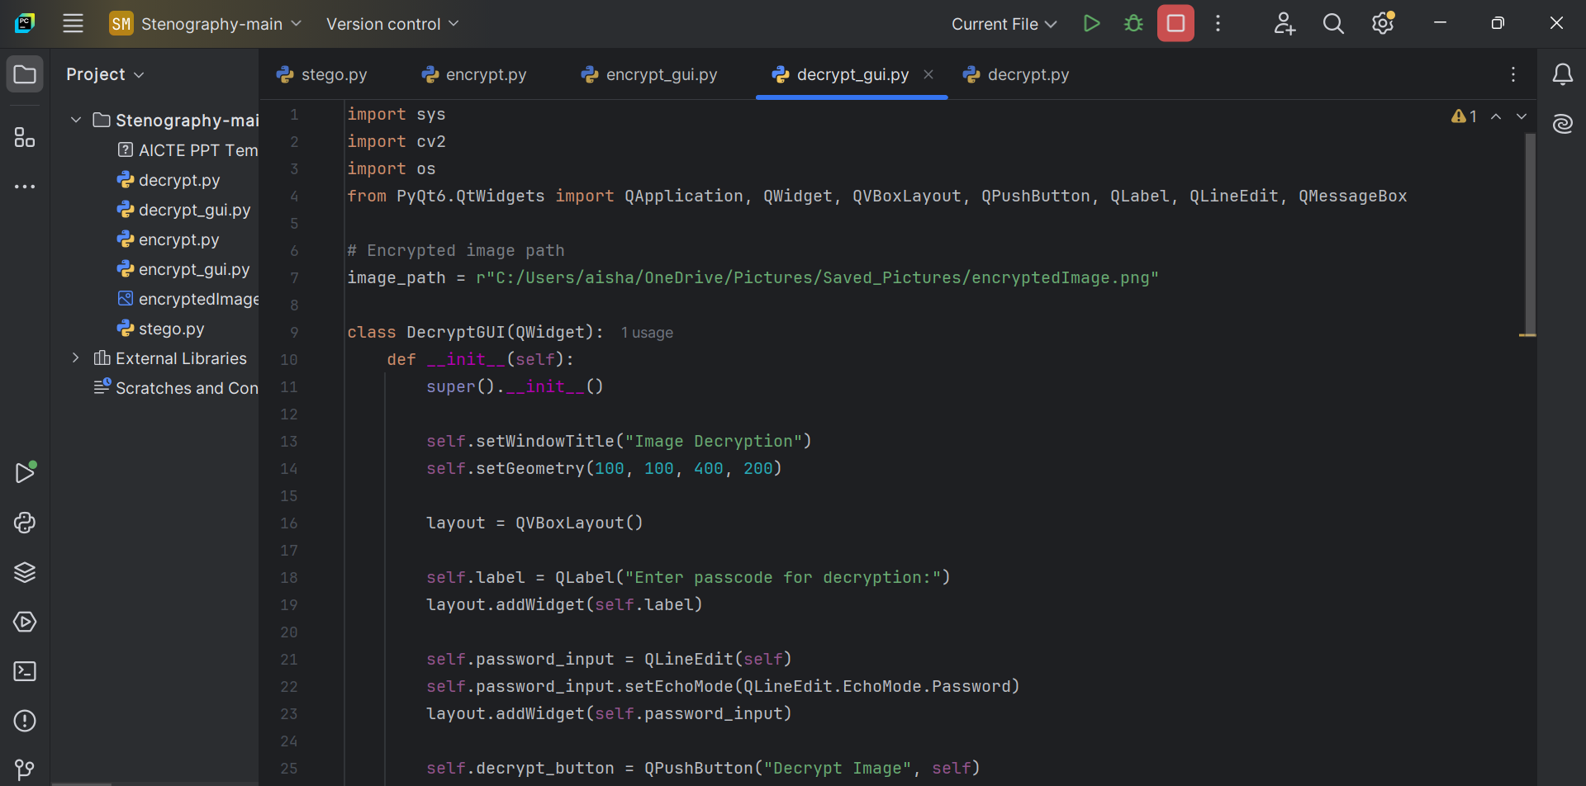
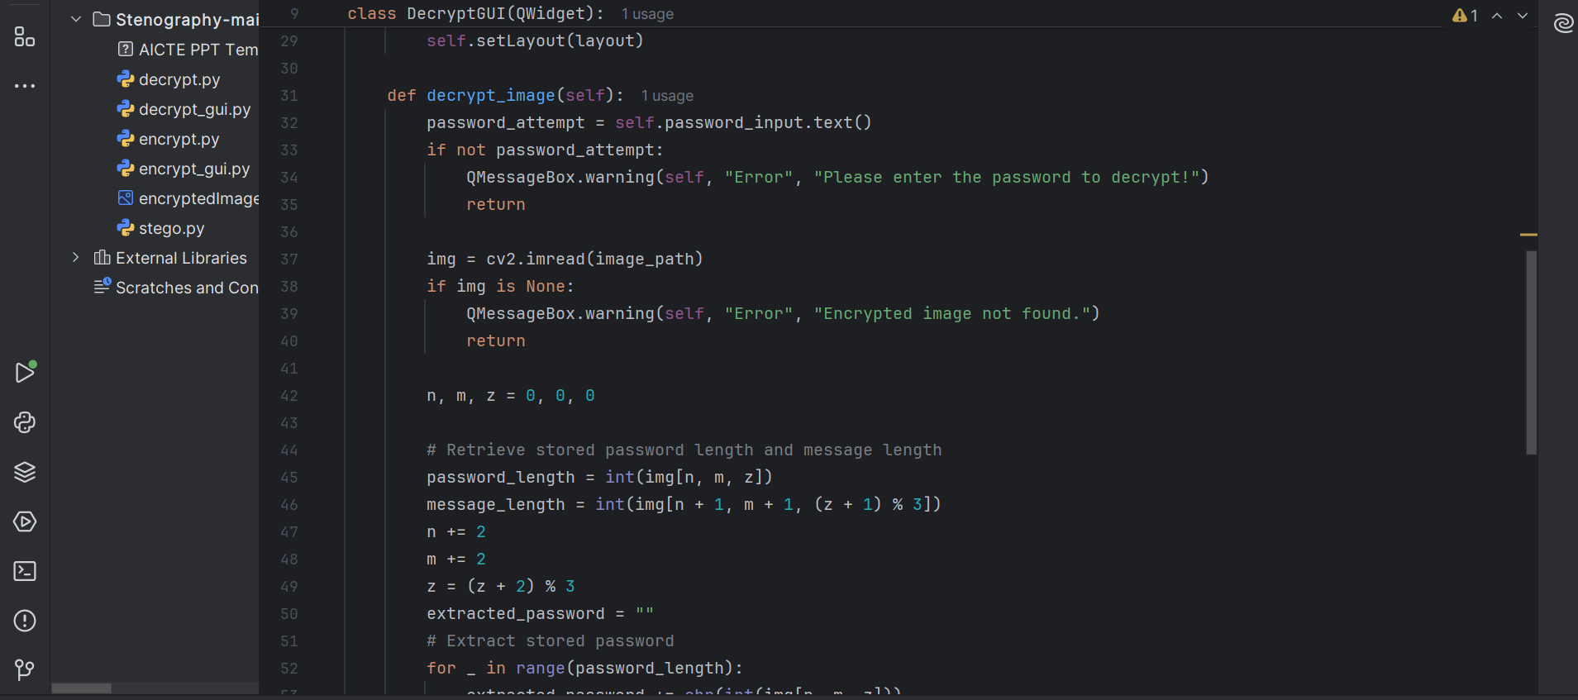
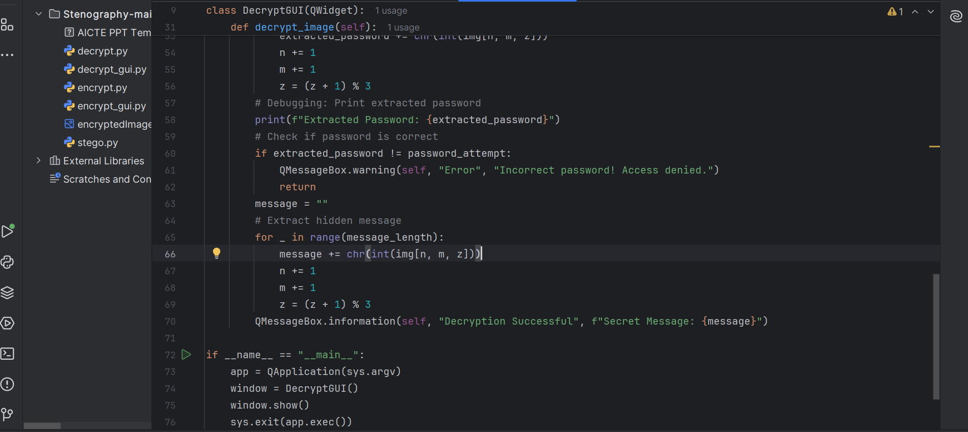
Figure 3: Decryption code

Slide 10
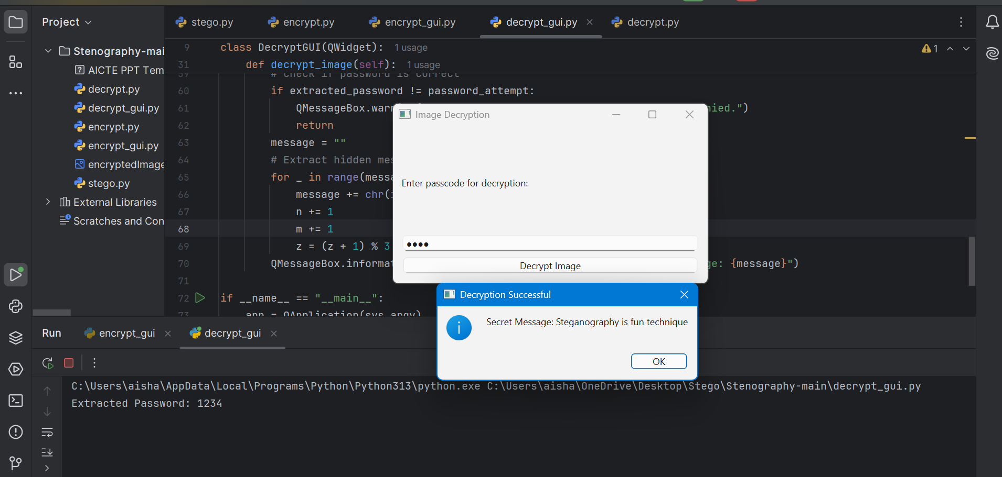
Figure 4: Decryption Output

Slide 11

Figure 5 : Encrypted Image

Slide 12
Conclusion
This project provides a simple yet effective way to securely encrypt messages within images using steganography and password protection.
By integrating a graphical user interface(GUI), the system is made accessible to both technical and non-technical users.
The use of OpenCV and NumPy enables fast and efficient message embedding and extraction without significant image distortion.
The project successfully demonstrates a practical application of image-based cryptography for secure communication.

Slide 13
GitHub Link
https://github.com/GowthamGeddada/AICTE_Encryption_Decryption_Project-main

Slide 14
Future scope(optional)
Enhanced Security – Implement AES or RSA encryption alongside steganography for dual-layer security approach.
Support for Multiple Image Formats – Extend compatibility beyond PNG to formats like JPG, BMP and TIFF.
Mobile & Web Integration – Develop a Mobile app or Web-based version for wider accessibility.
Deep Learning for Image Security – Explore AI-Based detection of tampered images and improve security features.

Slide 15
THANK YOU

